Slide 1

AI-Driven Targeted Subsidies to Reduce PM₂.₅ Emissions
Group:2
Prashansa Rathod 8993410
Nidhi Ahir- 9041129
Jaiv Burman 8930180
Harsh Joshi-8952840
Jagroop singh sandhu- 8980887

Slide 2


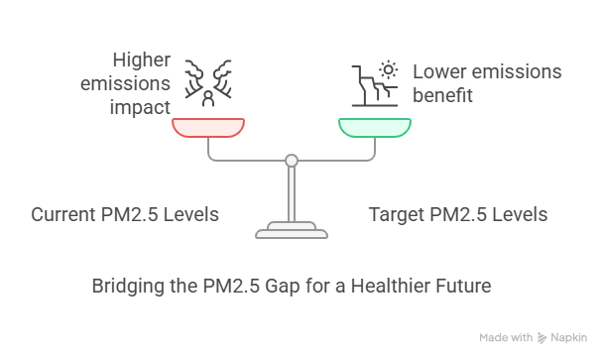
AI-Driven Targeted Subsidies to Reduce PM₂.₅ Emissions
Clean air is a right, not a luxury. Millions of households in rural and low-income areas rely on outdated, inefficient wood-burning stoves, contributing to dangerously high PM2.5 levels.
This issue not only threatens public health but also undermines environmental regulations.
By leveraging AI-driven insights to identify key PM2.5 contributors, we empower communities and policymakers to design smarter, cleaner, and healthier futures.
Through targeted solutions, we can bridge the 1.1 µg/m³ pollution gap and ensure cleaner, more efficient heating reaches those who need it most.

Slide 3
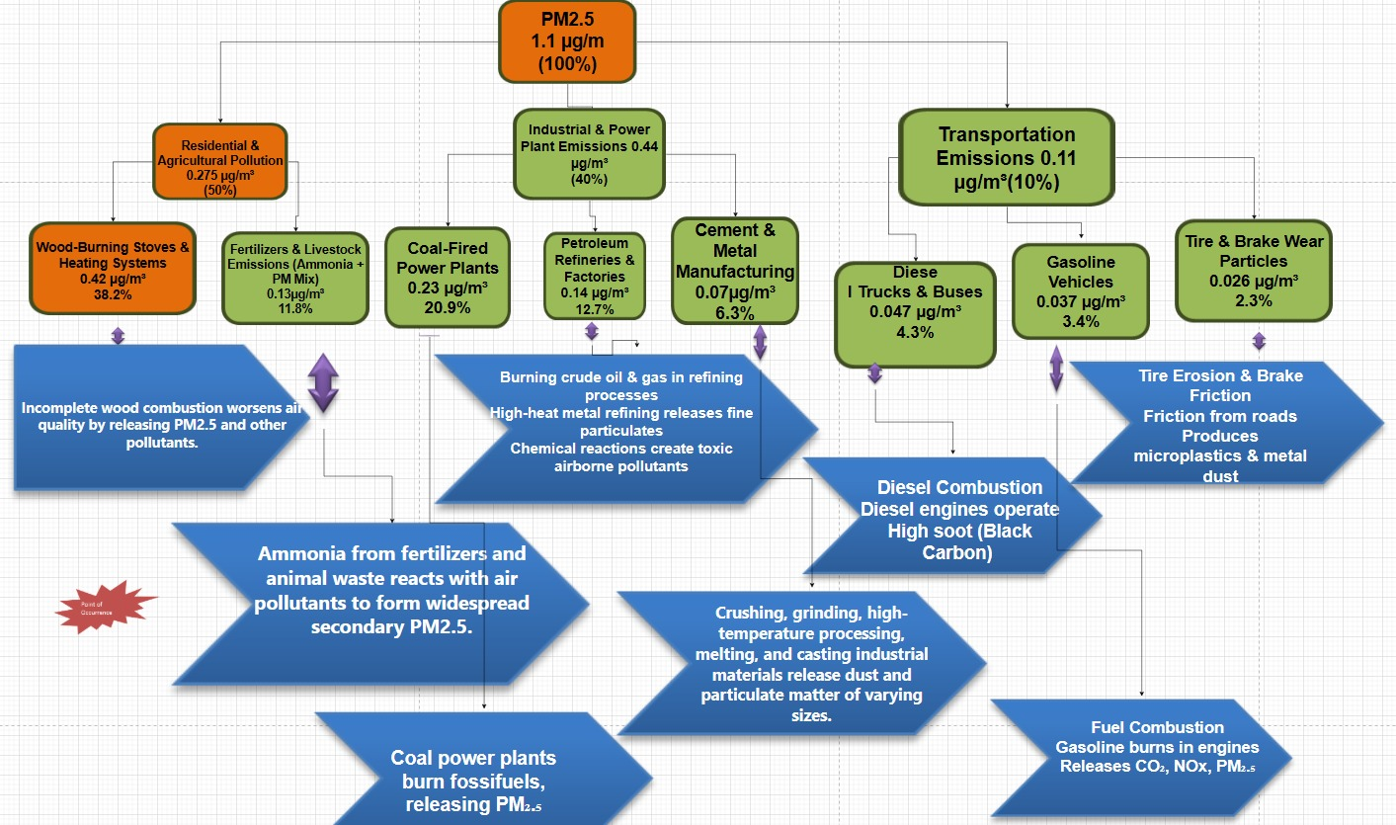
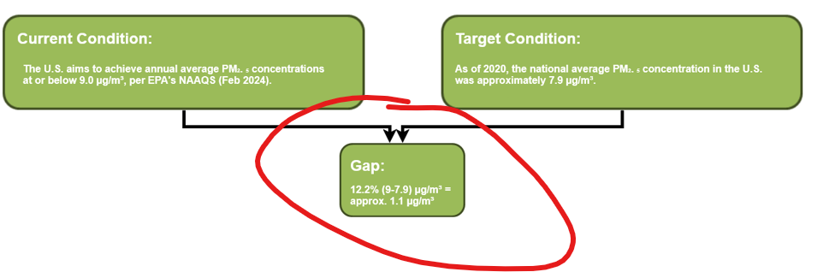
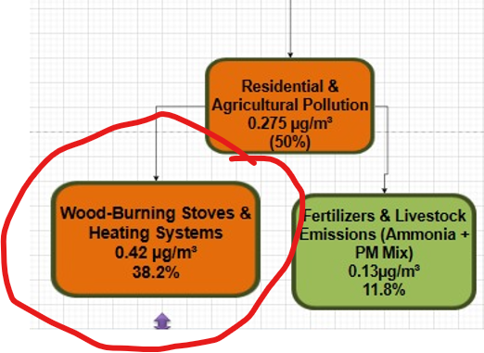
Residential & agricultural sources contribute 50% of PM₂.₅
Wood-burning systems alone = 38.2% of that
Government policies exist, but lack targeting
Gap: Current level = 9.0 µg/m³, Target = 7.9 µg/m³
Why it's a problem: High healthcare costs, public health risk, missed sustainability targets
https://www.epa.gov/stationary-sources-air-pollution/new-source-performance-standards-residential-wood-heaters

Slide 4
Why? | Root Cause Identified
1️. Why does wood-burning contribute to PM₂.₅ pollution? | Because incomplete combustion releases fine particulate matter
2️. Why does incomplete combustion occur? | Many stoves are outdated, inefficient, or use low-quality fuel
3️. Why are inefficient stoves & fuels still widely used? | Wood-burning is a cheap & accessible heating method, especially in rural regions
4️. Why are cleaner alternatives not affordable or accessible? | Government incentives & infrastructure for cleaner heating are insufficient
5️. Why has there been limited government action? | Policymakers lack real-time insights to target subsidy distribution effectively
6. Why do policymakers lack real-time insights and quantifiable public demand? | Because there's a lack of accessible household-level data on heating methods, income levels, fuel type usage, and adoption of clean alternatives especially geospatially segmented.
https://www.ibm.com/case-studies/nukissiorfiit-cognos-analytics

Slide 5
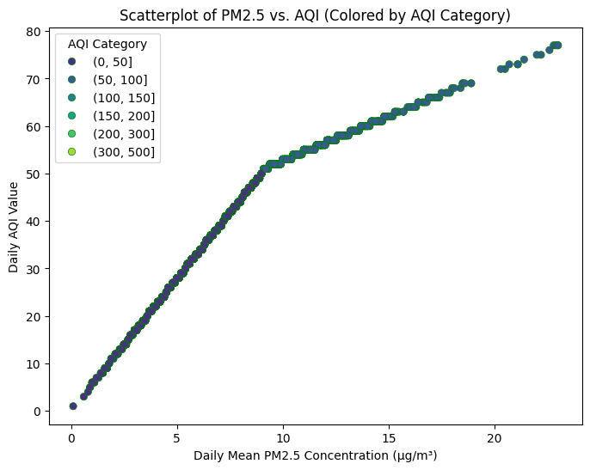
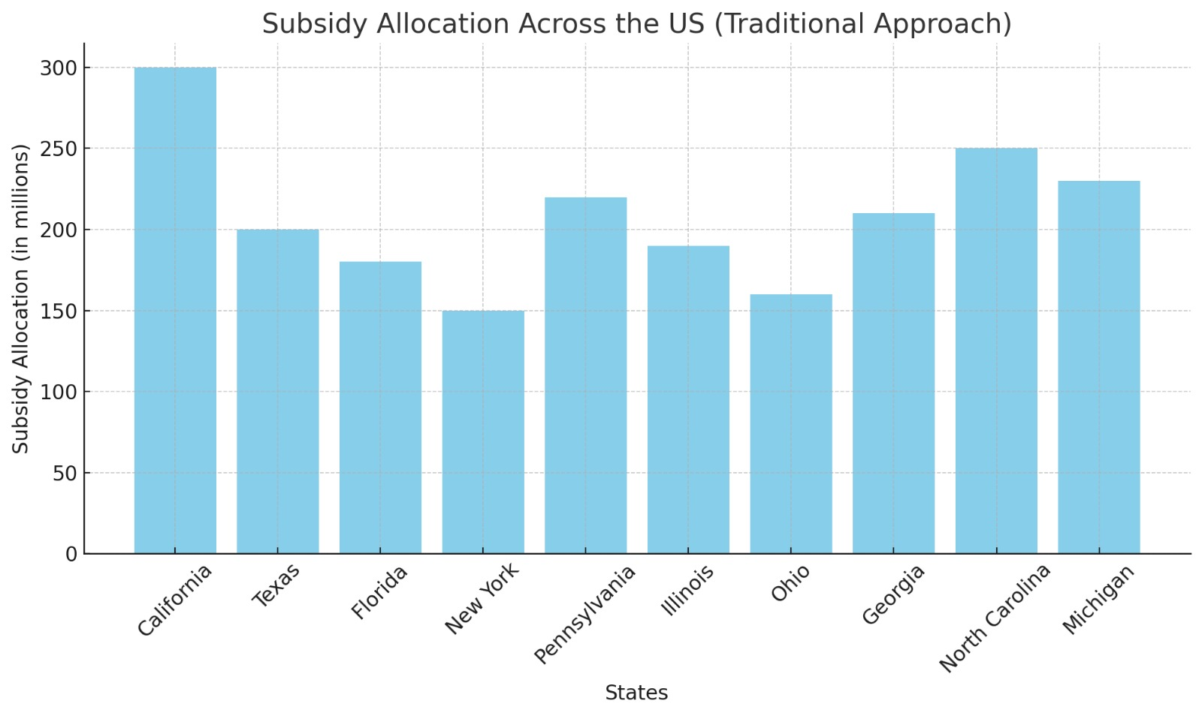

Slide 6
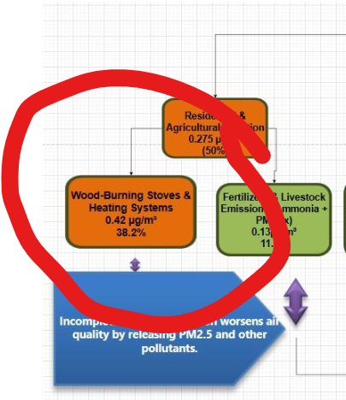
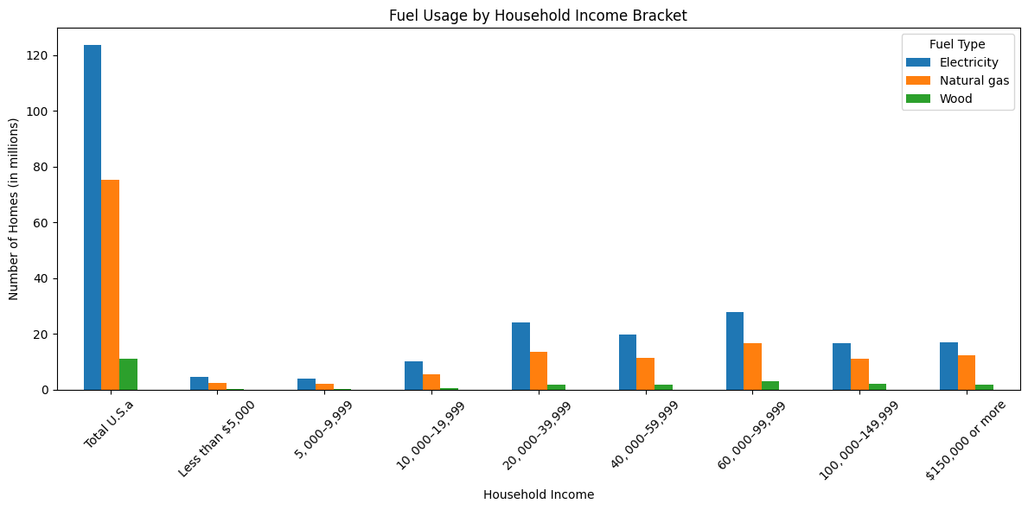
Connection with our problem

Slide 7
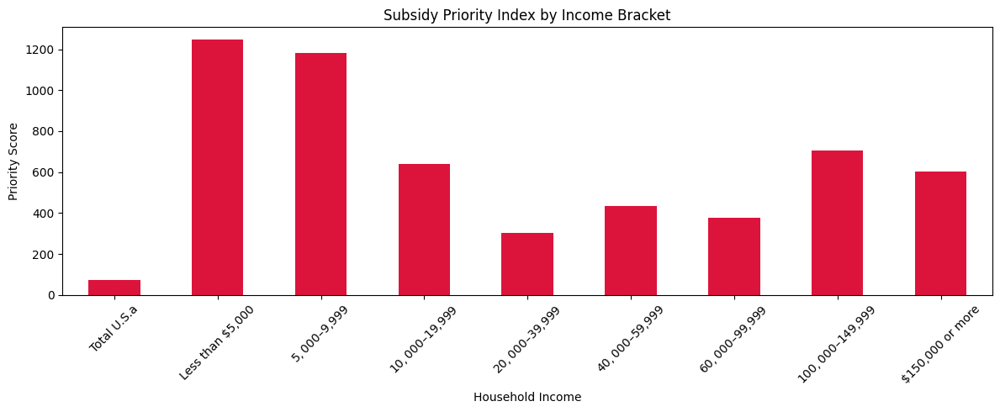
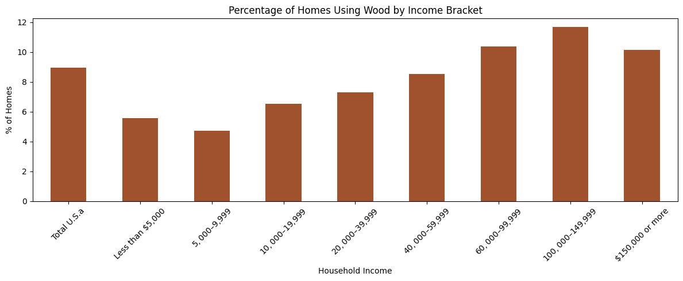
VISUALS
VISUALS

Slide 8
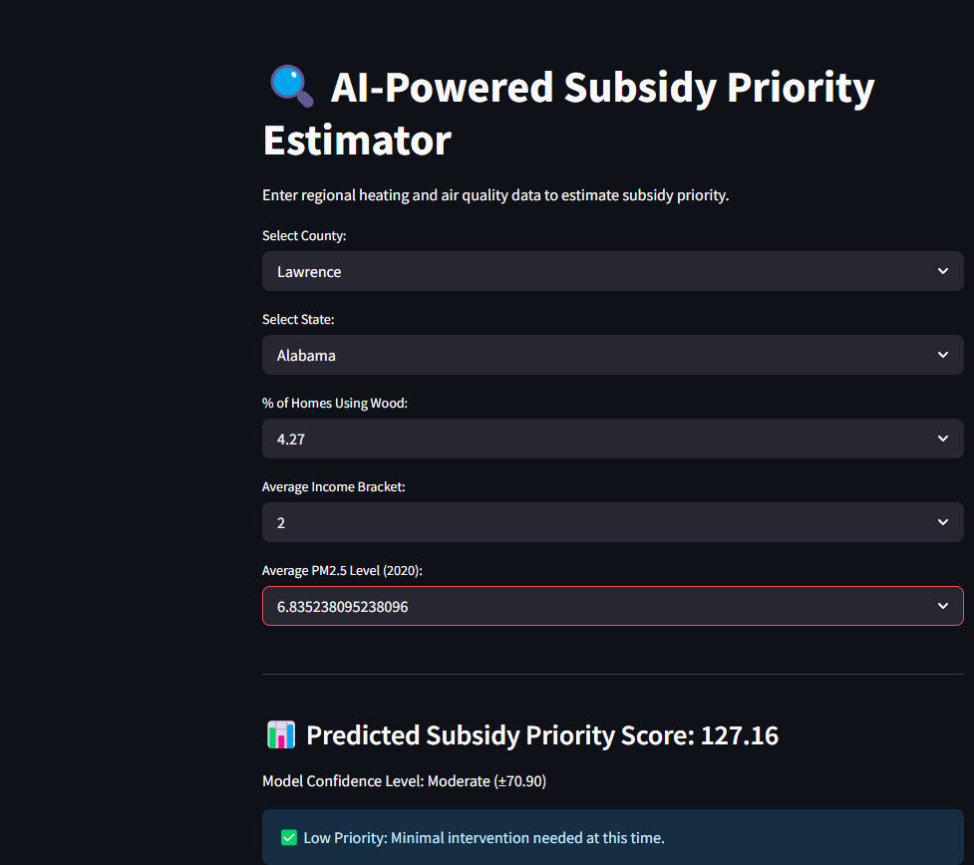
Dashboard for our Stake Holder

Slide 9
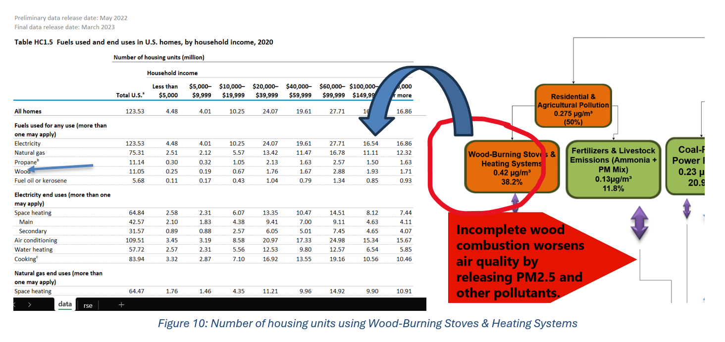

Slide 10
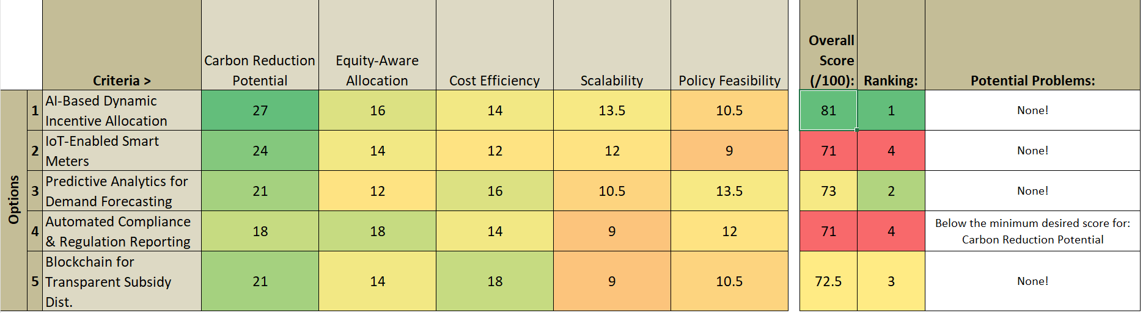
AI-Based Dynamic Incentive Allocation emerged as the top-performing countermeasure due to its superior performance across all five critical evaluation criteria.
According to a recent study by researchers in the U.S. Northeast, this approach achieved up to32.23% higher carbon reductions compared to traditional incentive schemes.
Moreover, it demonstrated an equity-aware framework that retained 78.84% of optimal reductions, ensuring fair distribution across socio-economic groups —an essential policy goal.
https://github.com/prashansarathod/CSCN8040

Slide 11
THANK YOU

